Slide 1
SvSAN : Software defined Storage
Virtual SANs made simple
Andreas Fleischmann – Lead Technical Consultant Prianto
Jens Gerlach – Field Sales Manager StorMagic

Slide 2
Eine Definition für Hyper-konvergente Infrastruktur
„Hyper-Konvergenz (Hyper-Convergence) bezeichnet eine Art von Infrastruktur-Systemen mit einer Architektur, bei der die Software im Mittelpunkt steht. Sie integriert Computing-, Storage-, Netzwerk- und Virtualisierungs-Ressourcen sowie andere Technologien sehr eng miteinander. Dabei kommt Standard-Hardware zum Einsatz und ein einzelner Anbieter bietet Support für das gesamte Produkt.“
Quelle : searchdatacenter.de

Slide 3
Trend to Hyper-converged Infrastructure (HCI)
3%
1-3 MONTHS
24 %
YES
8%
3-6 MONTHS
24%
> 2 YEARS
41 %
PLANNING
22%
6-12 MONTHS
CURRENT
HCI USER
74% PLANNING
IN < 2YEARS
43%
1-2 YEARS
35 %
NO
Source: 2015 State of Hyperconverged Infrastructure Market.
ActualTech Media. May 2015.

Slide 4
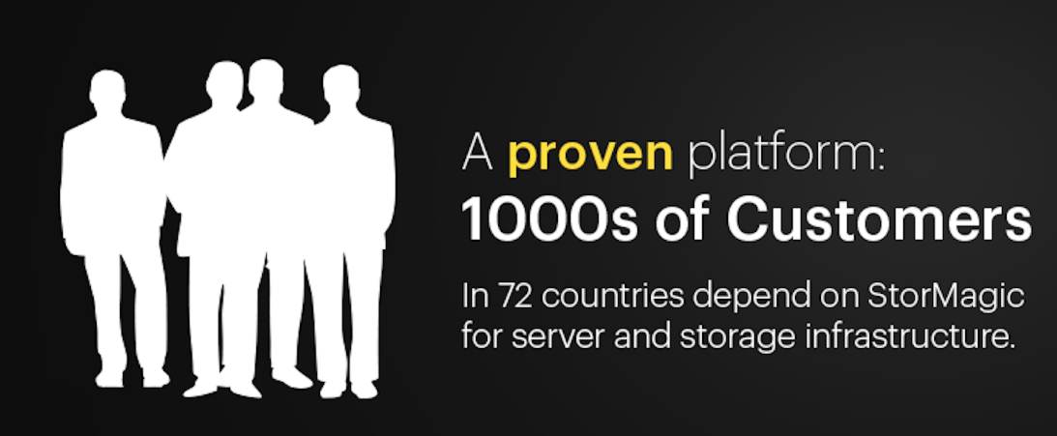
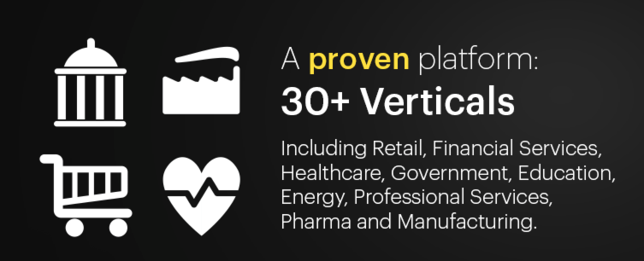
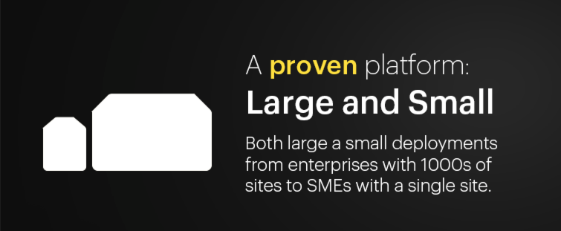
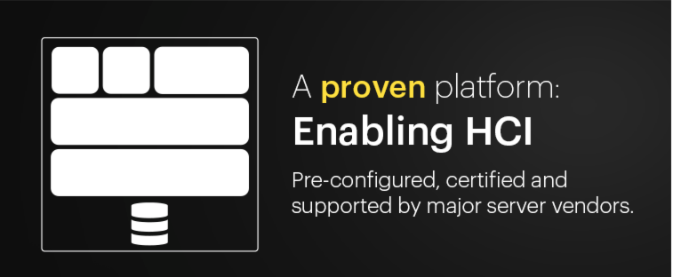
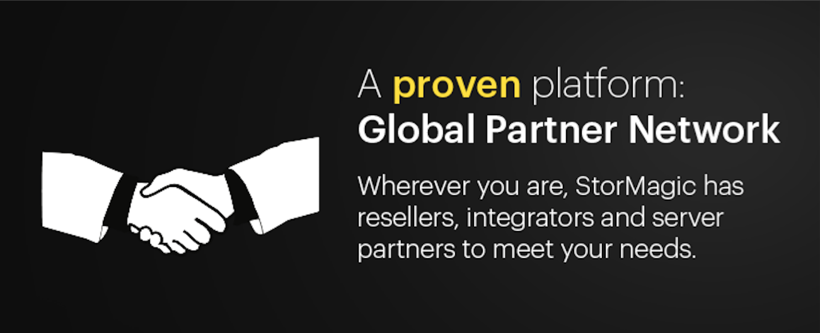
StorMagic: Established a Proven Platform

Slide 5
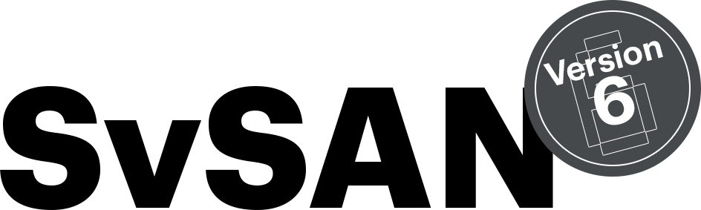

StorMagic: Focused on Solving Customer Challenges
Reducing cost and complexity
Delivering application performance
Simplify & centralize management
Ensure application uptime
Notes:
Challenge #1 –Reducing cost and complexity
Multi-site enterprises and SME organizations need to keep the IT infrastructure footprint to a minimum with lower storage capacity requirements making the option of external SAN overkill adding unnecessary cost, complexity and a single point of failure.
Challenge #2 –Ensuring application uptime
IT equipment failures lead to application downtime, resulting in loss of revenue, staff productivity and customer service impacting profit and customer satisfaction. Enterprises with ROBO environments will often compromise uptime due to the perceived high cost and complexity of high availability.
Challenge #3 –Delivering application performance
Poor performance associated with accessing data over a high latency, low bandwidth network link could lead to unacceptable processing delays, contributing to a poor customer experience. Traditional applications in verticals such as retail, manufacturing and healthcare are now being joined by the a new breed of IoT applications at the edge of the network where significant processing of data is required away from the datacenter.
Challenge #4 –Minimize deployment time
Reducing the time to deploy an IT solution is an important factor for ROBO environments. Implementation time is directly related to number of sites, solution complexity & site locality.
Challenge #5 –Simplifying and centralizing management
ROBOs lack local skilled IT staff, with organizations preferring to centralize this function at head office or the data center. Maintaining IT infrastructure at remote sites becomes increasingly challenging and impacts the ability to scale and recover from outages.

Slide 6
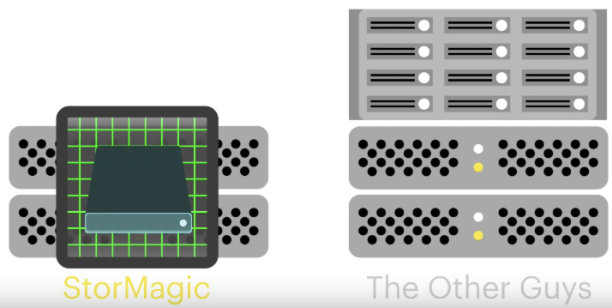
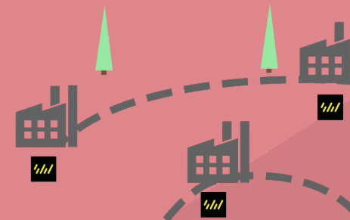
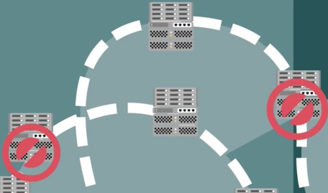
SvSAN: Why 1000s of Customers have Deployed
Affordable & Simple
Highly available
Costly & Complex
Single point of failure
Notes:
Slide objective:
Deliver a crystal clear message of the value of SvSAN vs a physical SAN as a simple summary after the Dave and Larry video or on its own if the video is not shown.
Link statement:
“I trust the message from the video is clearly understood. In summary, a Physical SAN is costly, complex and a single point of failure; whereas SvSAN is affordable, simple and highly available.”.
Key messages to deliver:
A physical SAN adds a 3rd piece of highly complex and costly infrastructure to the deployment.
By leveraging the internal disk of a server SvSAN delivers a more affordable, simple and highly available solution.
Built from the ground up for lean IT spaces.

Slide 7
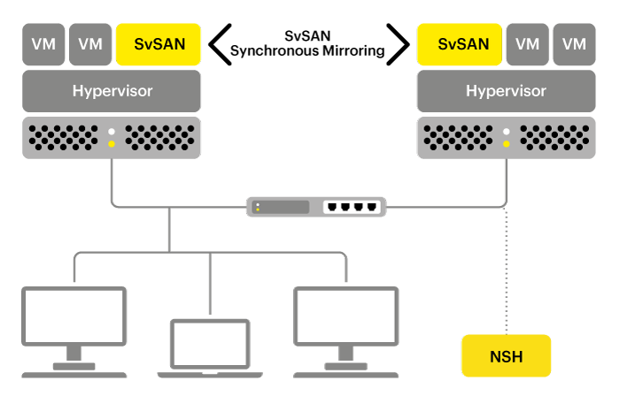
SvSAN: How it works and what you get
SvSAN turns the internal/direct attached disk of 2 servers into highly available shared storage
Key benefits are:
  Lowering costs by eliminating physical SANs and deploy on only 2 servers whilst not compromising performance.
  Improved management and support though rapid deployment and centralized management.
  High availability out-of the box whilst eliminating a physical SAN single point of failure.
Notes:
Challenge #1 –Reducing cost and complexity
Multi-site enterprises and SME organizations need to keep the IT infrastructure footprint to a minimum with lower storage capacity requirements making the option of external SAN overkill adding unnecessary cost, complexity and a single point of failure.
Challenge #2 –Ensuring application uptime
IT equipment failures lead to application downtime, resulting in loss of revenue, staff productivity and customer service impacting profit and customer satisfaction. Enterprises with ROBO environments will often compromise uptime due to the perceived high cost and complexity of high availability.
Challenge #3 –Delivering application performance
Poor performance associated with accessing data over a high latency, low bandwidth network link could lead to unacceptable processing delays, contributing to a poor customer experience. Traditional applications in verticals such as retail, manufacturing and healthcare are now being joined by the a new breed of IoT applications at the edge of the network where significant processing of data is required away from the datacenter.
Challenge #4 –Minimize deployment time
Reducing the time to deploy an IT solution is an important factor for ROBO environments. Implementation time is directly related to number of sites, solution complexity & site locality.
Challenge #5 –Simplifying and centralizing management
ROBOs lack local skilled IT staff, with organizations preferring to centralize this function at head office or the data center. Maintaining IT infrastructure at remote sites becomes increasingly challenging and impacts the ability to scale and recover from outages.

Slide 8



SvSAN 6: The Perfect Antidote to Solving Your IT Challenges
StorMagic SvSAN 6 delivers unprecedented Robustness, Cost Effectiveness and Flexibility to modernize your IT
Robust
Cost-Effective
Flexible
Availability
Any site, any network
Lightest footprint, lowest cost
Today’s needs, future proofed
Data & operations protected
No single point of failure
Local and stretched cluster capable
Split-brain risk eliminated
Proven at the IT edge and the datacenter
From harshest to the most controlled
Supports mission critical applications
Tolerates poor, unreliable networks
Enterprise-class management
Integrates with standard tools
Automated deployment and recovery scripts
Designed for use by any IT professional
No more physical SANs
Converge compute and storage
Utilize power of commodity servers
Eliminate storage networking components
Lowest CAPEX
Start with only 2 servers - existing or new
Significantly less CPU and memory
One lightweight quorum for all clusters
Lowest OPEX
Reduced power, cooling and spares
Lower costs with centralized management
Eliminate planned and unplanned downtime
Performance and scale
Leverage any CPU and storage type
Active/Active synchronous mirroring
Scale-up performance with 2 node cluster
Build-your-own Hyperconverged
Eliminate appliance overprovisioning
Configure to precise IOPS & capacity
Auto-tier disk, SSD and memory
Flexibility and growth
Hyperconverged or storage-only
Hypervisor and server agnostic
Non-disruptive upgrades

Slide 9
SvSAN 6: What’s under the covers?
Robustness
The design principle:
Leveraging all available storage types
Designed for virtualization and optimize read/write where it counts
Based on data from real-world customer environments
Deliver improved management through extended automation
What you can expect:
Lower cost servers and storage to save CAPEX
Lower operating costs to save OPEX
Smaller footprint with lower power consumption to save OPEX lower CF
Higher performance for most demanding applications
Any site, any network
Cost Effectiveness
Lightest footprint, lowest cost
Flexibility
Today`s needs, future proofed
9

Slide 10
SvSAN 6: Standard & Advanced Editions
STANDARD
ADVANCED
Minimum cluster size | 2
Synchronous Mirroring/High Availability | ✔
Stretched/Metro Cluster Support | ✔
Volume Migration | ✔
VSA Restore¹ | ✔
VMware vSphere Storage API (VAAI) Support | ✔
Centralized management & monitoring | ✔
Remote shared quorum | ✔
I/O performance statistics | ✔
Multiple VSA GUI deployment & upgrade | ✔
PowerShell Shell script generation | ✔
SSD Caching | -
Memory Caching | -
Intelligent Auto Tiering | -
2
✔
✔
✔
✔
✔
✔
✔
✔
✔
✔
✔
✔
✔
Capacity
2TB
6TB
12TB
Unlimited TB
¹ Vmware vSphere only
*Available in SvSAN 6.1 – GA November 2016
Notes:
Storage link aggregation – Team multiple network links to aggregate network bandwidth for SvSAN mirror traffic
vCenter Dashboard – centalized monitoring
vCenter event forwarding – centralized monitoring
Microsoft System Center Operation Manager Management Pack – Centralized monitoring
Cisco UCS Director integration – Centralized management
Heterogeneous storage – the ability to use any storage type
Monitoring options – SNMP & SMTP (email) events – Centralized management

Slide 11
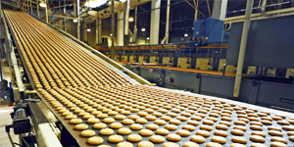







SvSAN 6: Meeting and Exceeding Customer Expectations
“We were looking to modernize our IT infrastructure, but with a small IT budget to invest in new solutions. We needed a solution that worked within our existing VMware environment and provided highly available storage.
StorMagic SvSAN eliminated single points of failure and displayed good performance.”
Jan Valenta, Network Administrator
Technické služby města Mostu a.s.
“Our old storage platform was a poor fit, troubling us with low performance and reliability issues - so we chose SvSAN. We're happy with SvSAN and will be deploying SvSAN in other projects.”
Will Turner
Merit Network
“Previously we had a Dell Physical SAN but when our support ran out we looked at other options. We looked at other virtual SAN solutions, but unlike the others StorMagic SvSAN ticked all our boxes: low support cost, low outlay cost and reliability. We’re very happy with StorMagic SvSAN and are now looking at deployment into our other offices.”
Barry Nelson, I.T. Manager
Adam Equipment Company

Slide 12
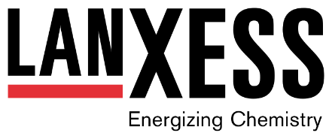

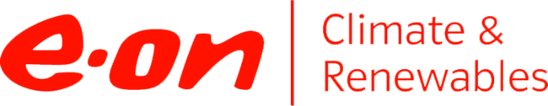



Hundreds of customers, large and small, cross vertical
Save time, money and reduce your carbon footprint

Slide 13
SvSAN 6: Built on Customer Data and a Proven Platform
Robustness
Proven Platform:
1000s customers in production
Only company singularly focused on a 2 server solution
Only 2 server solution with all storage tiers supported
Built on real customer data
Not in the lab!
Benefit immediately whatever the workload
Perfect Storm:
Continued increase in Intel processor density
HD Capacity is going through the roof
Flash prices are dropping through the floor
Any site, any network
Cost Effectiveness
Lightest footprint, lowest cost
Flexibility
Today`s needs, future proofed

Slide 14
Live Demo

